Slide 1
Coll 400 Presentation
Adam Chisholm Conner Wright Elijah Gilliam Zachary Klein

Slide 2
Abstract
This project addresses the problem of classifying network traffic by its website of origin. The goal of this classification is to improve providers' ability to manage their networks based on users' activity. The traffic records we analyzed come from five websites – Backloggd, Github, Letterboxd, Reddit, and weather.com - and, based on nine characteristics, classified the records with the Linear Regression, Logistic Regression, and Random Forest models.

Slide 3
Introduction
Dataset of traffic records from GitHub, LetterBoxd, Backloggd, Reddit, and Weather.
Dataset was split into training, and test sets
3 models used for classification
Linear Regression
Logistic Regression
Random Forest
Random Forest achieved the highest accuracy and Macro F1 score

Slide 4
Data Preparation
Wireshark
network protocol analyzer
configuring filters to capture traffic from specific web sites
Features Collected
Packet Count
Total Length
Average Packet Interval
Maximum Packet Interval
Minimum Packet Interval
Average Packet length
Maximum Packet Length
Minimum Packet Length
Most Common Packet Length

Slide 5
Employed Method
Random Forest
Constructs multiple decision trees during the training phase then aggregates their outputs to make a final decision.
Process:
Building the Forest
Voting Mechanism
Robustness and Stability
Resistant to overfitting
Benefits:
Handling Complex Features
Protocols and Packet Length
Generalization
Variation in traffic patterns
Interpretability
Scalability

Slide 6
Employed Method
Compared two Baselines
Linear Regression
Logistic Regression

Slide 7
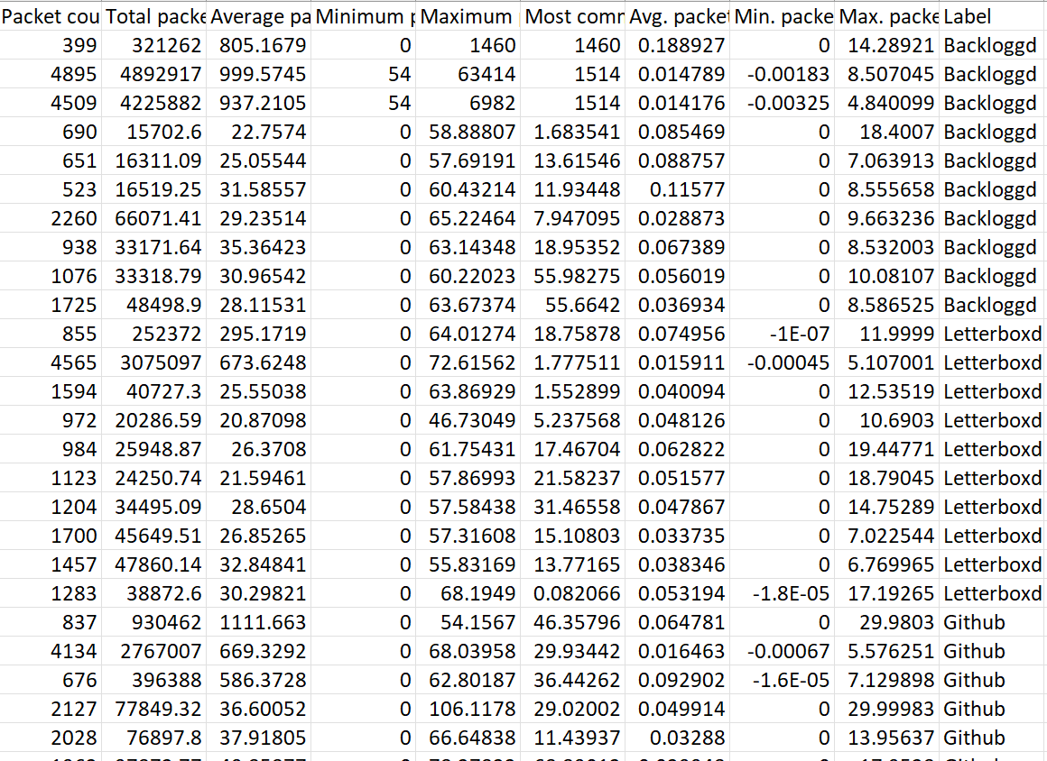
Dataset
The training and test sets were split with a ratio of 50:50
10 captures for each label/website

Slide 8
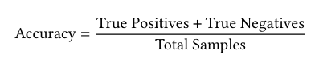

Evaluation Metrics
Primary Metrics
Accuracy
Macro F1 score

Slide 9
Evaluation Results
Linear Regression Accuracy: 0.36 Linear Regression Macro F1: 0.34
Logistic Regression Accuracy: 0.48 Logistic Regression Macro F1: 0.47
Random Forest Accuracy: 0.68 Random Forest Macro F1: 0.68

Slide 10
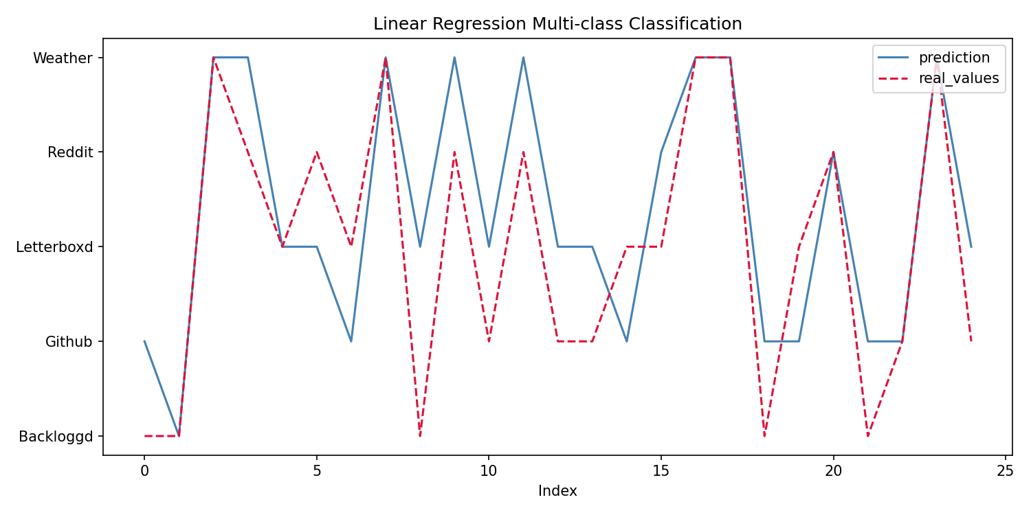
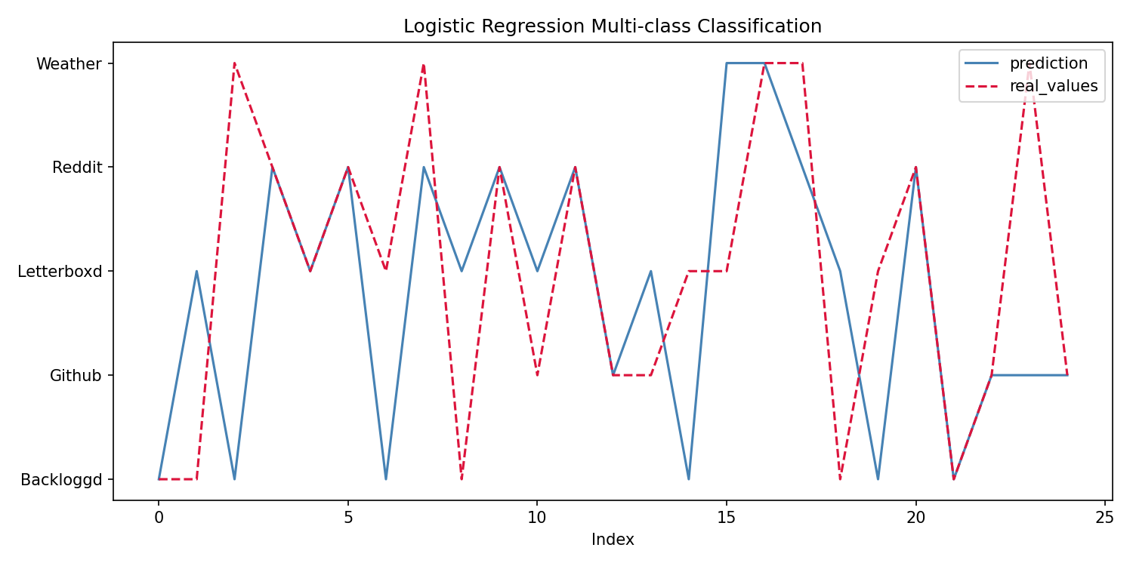
Visualization Results

Slide 11
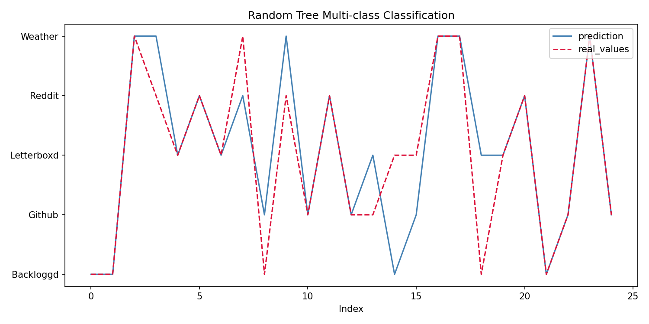

Slide 12
Interpretation of Results
Some models more accurate than others
Some features may be more significant than others

Slide 13
Future Work
Improvements
Expansion of the Dataset
Advanced Models
Real-Time Processing
Practical Applications
Challenges
Dataset Size, Complexity
Handling Real-Time Data
Model Complexity

Slide 14
Conclusion
Main insights
Random Forest model outperformed the other models
Importance of dataset size and its need for increase in size for future work
Shows how machine learning can help with classification of network traffic patterns

Slide 15
References
Network Traffic Classification Techniques: A Survey | IEEE Conference Publication | IEEE Xplore
Wireshark • Go Deep
Machine Learning Made Easy: A Review of "Scikit-learn" Package in Python Programming Language on JSTOR
RandomForestClassifier — scikit-learn 1.8.0 documentation

